Slide 1
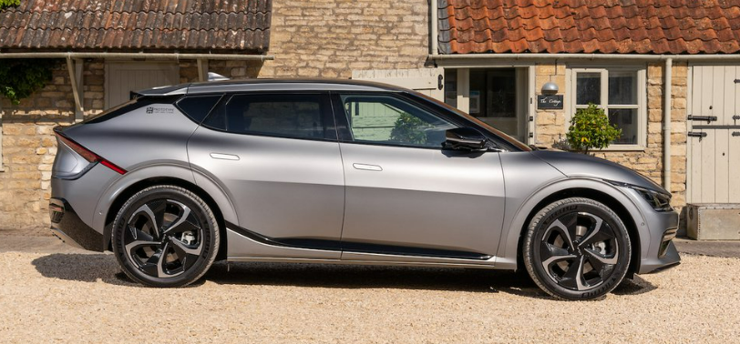
The fully electric KIA EV6
Purva Raut

Slide 2
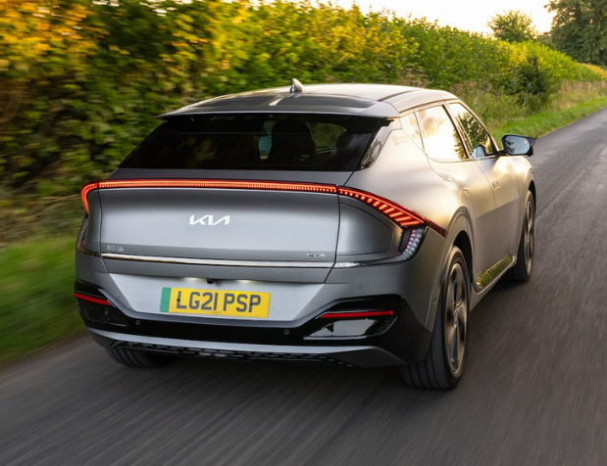
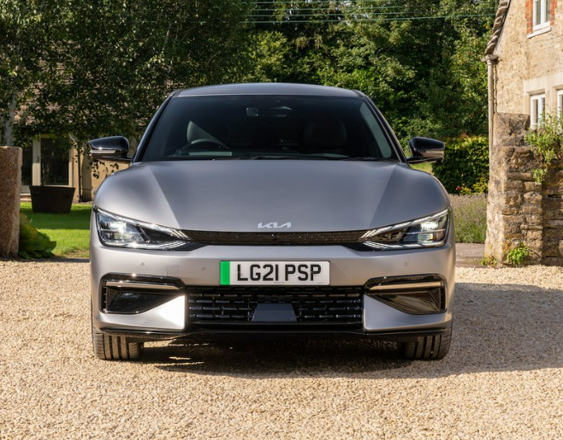
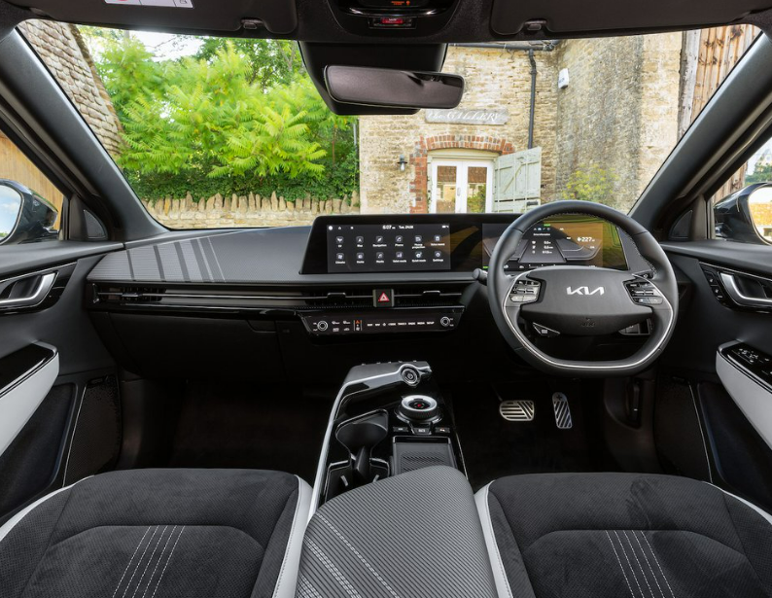
Agenda
Introducing KIA EV6
Why KIA EV6?
KIA EV6 vs Ioniq 5
KIA EV6 electric range
Quote
Summary
Thank you

Slide 3
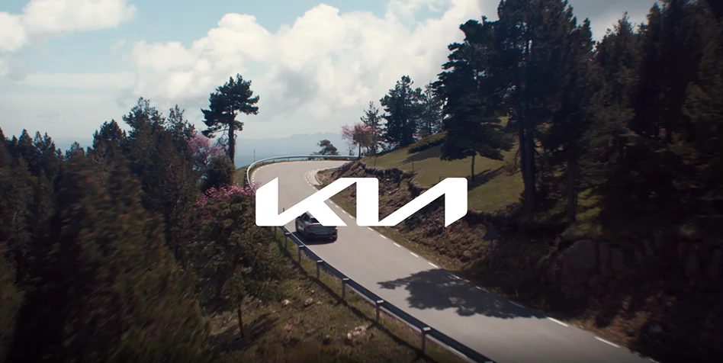

Slide 4

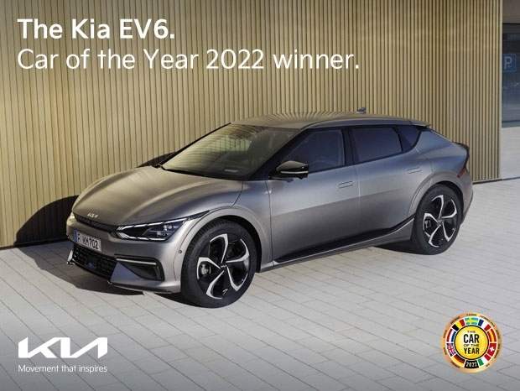


Why KIA EV 6?
Long Range: 328 miles
Fast Charging : 18 minutes - 80% battery
Practical Seating: Spacious and reclining seats
Amazing Warranty: 7-year or100,000 miles warranty
Well Equipped: Device to double the charging port to a three-pin plug
Impressive Refinement: Quiet cruising
Notes:
KIA EV6 WINS ‘CAR OF THE YEAR’ AT 2022 WHAT CAR? AWARDS

Slide 5

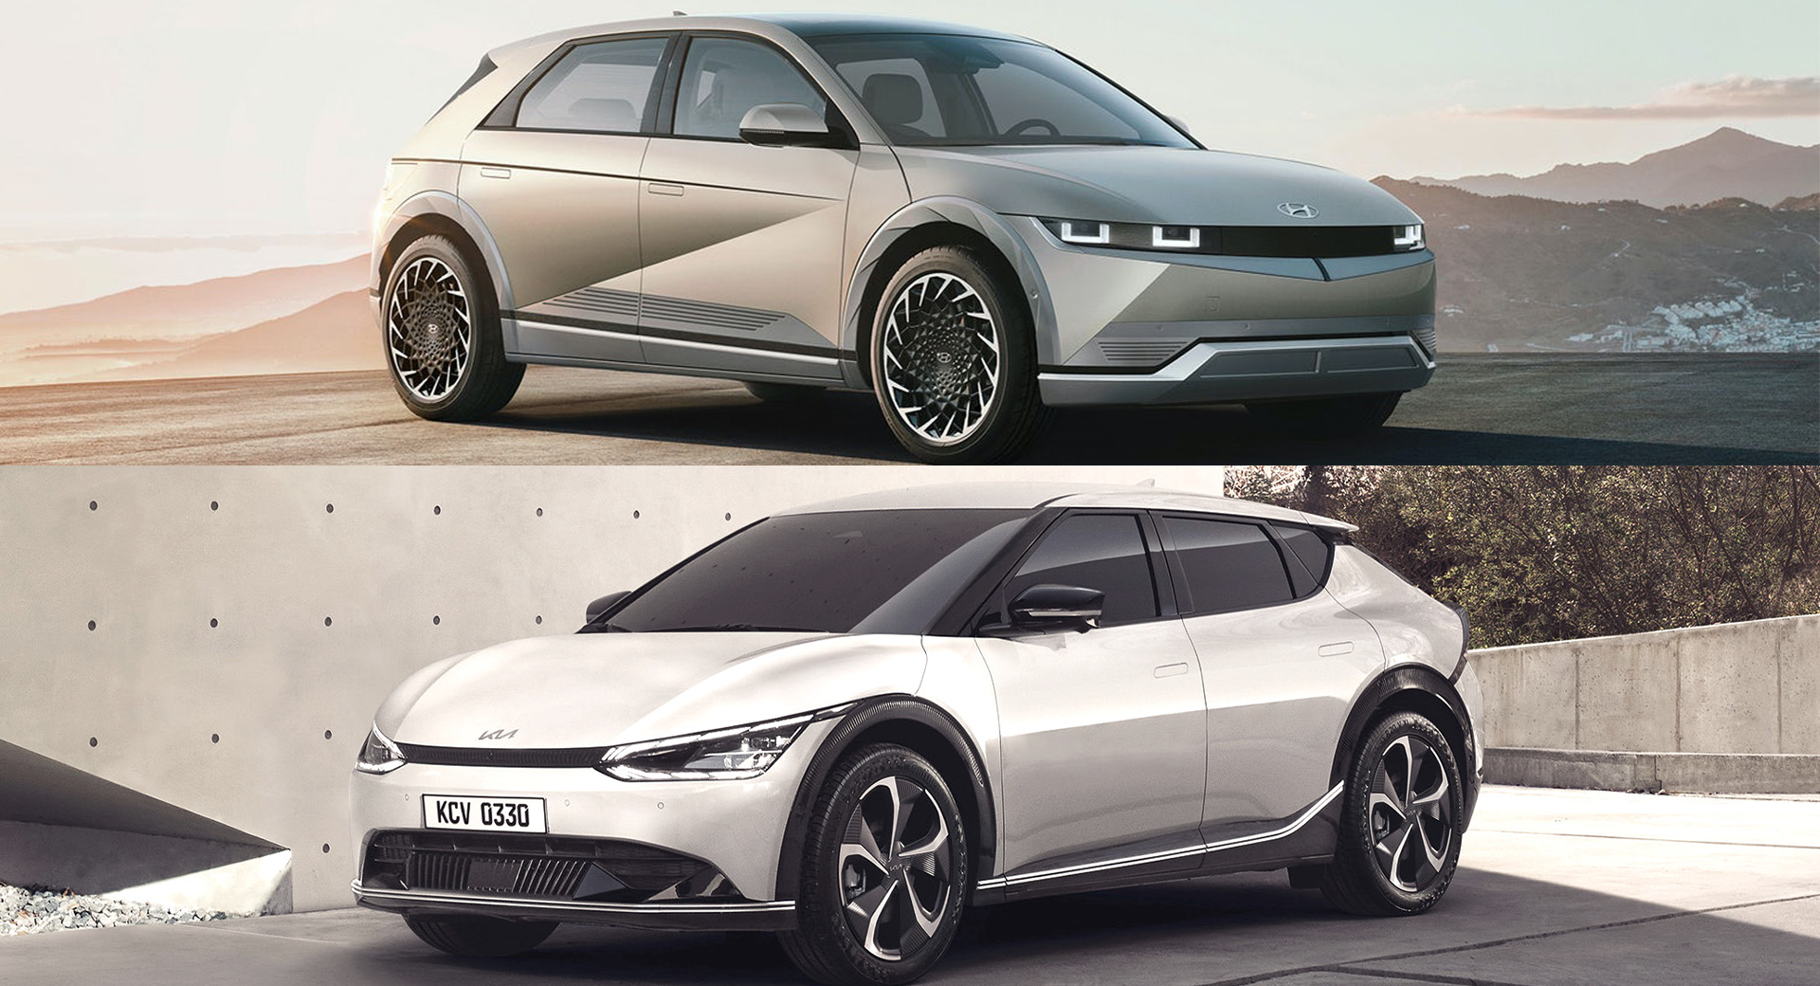
KIA EV6 vs ioniq 5
SPECIFICATIONS | KIA EV6 | HYUNDAI IONIQ 5
Value | £41000 | £37000
Range | 328 miles | 239 miles
Top speed | 117 mph | 115 mph
Towing | 2,300 lbs | 1,650 lbs
Leg room | 41.7 in. (front)/39.4 in. (rear) | 42.4 in. (front)/39.0 in. (rear)
Design | A sporty design with a coupe-like profile and plenty of curvy elements, and its high rear deck complements that sporty theme. | Has sharper and features a retro theme inspired by Hyundai’s Pony Coupe from 1974.
DC Fast Charging Time (10-80% SoC) | 18 minutes | 18 minutes

Slide 6
Electric range for KIA EV6 Models

Slide 7
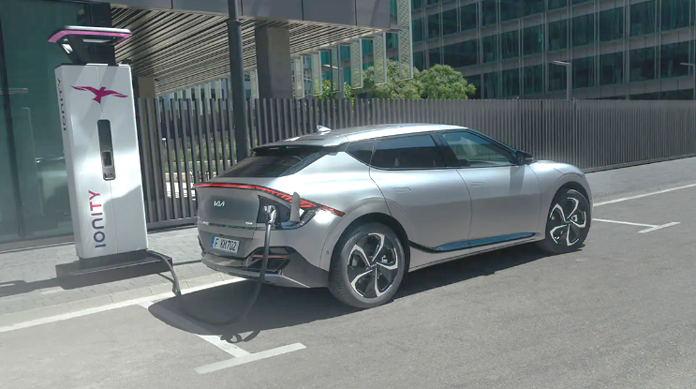

“The time is right for electric cars- in fact, the time is critical”
Carlos Ghosn

Slide 8
Summary
KIA EV6 combines a huge real-world range with the ability to charge at speeds that even some high-end electric cars can’t keep up with, addressing two of the biggest concerns that people still have about electric cars.
By basing the EV6 on bespoke electric underpinnings rather than a set that’s shared by petrol and diesel models, Kia has been able to take advantage of the compact size of electric motors and produce a car that’s hugely spacious and practical.
Add in its effortless performance, outstanding refinement, competitive pricing, and one of the best warranties around, and the striking EV6 doesn’t just look like the future – it feels like it too.

Slide 9
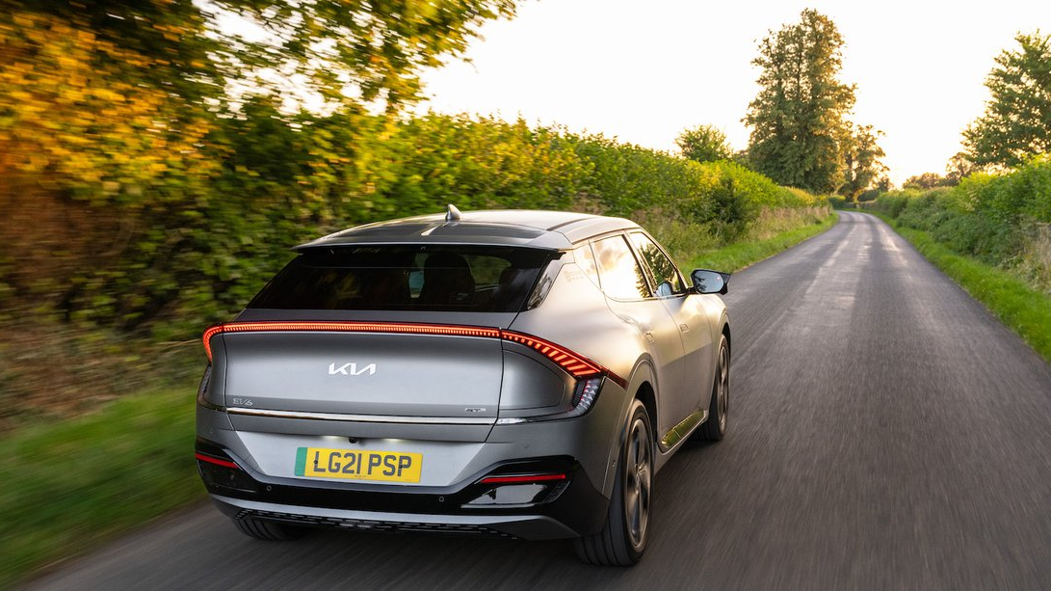
THANK YOU
Purva Raut
purva.raut@xandertalent.com

